Slide 1
Mobile Application Testing
Mobile Testing - Version 1.0

Slide 2
Agenda
1
Mobile Application Testing Lifecycle
2
Test Planning Factors
3
Test Case Design
4
Test Execution - Tools and Methods
5
Challenges in Mobile App Testing
6
Questions

Slide 3
Test Planning Factors
Technology/ Application Segment
Mobile OS – IOS, Android, Windows, and BBX
OS Version – Android 2.x to 4.x, iOS 5.x to 7.x, Windows 7 & 8
Hardware variations – iphone, ipad, Tablets, GPS, camera, Voice
Network – Wifi, 2G, 3G, 4G
Specific Testing Requirement
Functional – App specific functional requirements
Performance – Network Performance and Server Performance
External factors – Camera
Web - No installation required. Functional Test, Test Load time is important.
Hybrid - Installed & Launched > Function Test, Performance Test & UI not comparable to native app
Strategy – Time and Cost
Cloud - Offers web-based access to a huge number of REAL handsets and tablets connected to live networks spread globally in different geo-location. Ex. Perfecto Mobile.
Automation - Based on the type of application the tools will vary, Currently we initial Phase of using Perfecto mobile Automation.
Simulator/Emulator – useful for unit testing (Majorly used by Dev Team)
Device and Network
Native - Installed & Launched > Function Test, UI Test and Performance Test
Physical Devices - Testing done with Real Devices through mobile Lab
Security – Static Code Analysis
Usability – OS guidelines and Hardware Variations
Localization – language specific customizations in date, time
Device Browsers – Safari, Chrome, IE

Slide 4
Test Design
Best Practices to follow
Guidelines to be covered
Native Apps
Common Test Cases
Interface Testing
iOS App guidelines should be followed http://developer.apple.com/library/ios/#documentation/userexperience/conceptual/mobilehig/Introduction/Introduction.html
For Android Play store guidelines http://developer.android.com/distribute/googleplay/quality/index.html
Basic App can be tested using simulator/Emulator
Touch Screen , Track ball keypads
Layout and Design
Performance
The app performance in Wi-fi,2G,3G, 4G Network
Time to render screens
Dates, Time, Characters
Localization
Postal Code and Phone numbers
External Factors Testing
Phone calls interruptions
Text messages
Social media notifications (Face book, Twitter, etc.)
Alarm clocks
Performance,Usability,External factors like network, carriers camera features can be tested only using device.
Comparing app developed with the same category app in market and store.
Early UI Testing is possible for Mobile Native
Should be familiar in accessing the device like using shortcuts, taking screenshots
Cloud Testing can be done if there is lack of device, Network access. (Perfecto mobile, Device Anywhere etc)
Usability
Multi Tasking: Testing an application while running other applications simultaneously.
Data Persistence
Memory Management
Calendar events
Battery notifications
Validation of buttons, text inputs

Slide 5
Test Execution
Execution by Cloud:
Perfecto Mobile
Sign Up to get a free trial for an hour to use limited devices.
Execution by Device:
Real Mobile Device
Can be Carried out using Mobile Lab
Prerequisites – iOS
To install in Simulator -MAC OS, Xcode
To install in device - IPCU(for Windows Machine and MAC)
Prerequisites – Android
To install in Simulator in Windows Environment - Android SDK, Eclipse
To Install in device - Enable device settings to install non-Market applications.

Slide 6


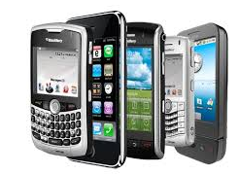

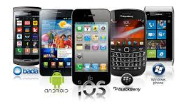
Test Execution – Using Real Device on Mobile Lab
From Server the Builds are SFTP’ed from Onshore
Builds will be downloaded through client machines at offshore using WinSCP tool
Downloaded builds can be installed on Mobile Devices using IPCU tool
Set up the Wi-Fi Connection on Devices
Installing builds through Server
App Testing Carried out

Slide 7
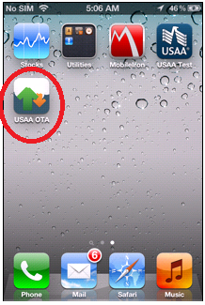
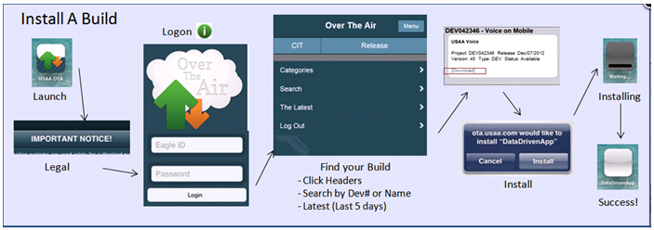
Test Execution – Using Real Device on Mobile Lab
Install The OTA App in all the mobile devices
Install the App using OTA
Set up the Wi-Fi Connection on Devices
Installing builds through OTA
App Testing Carried out

Slide 8
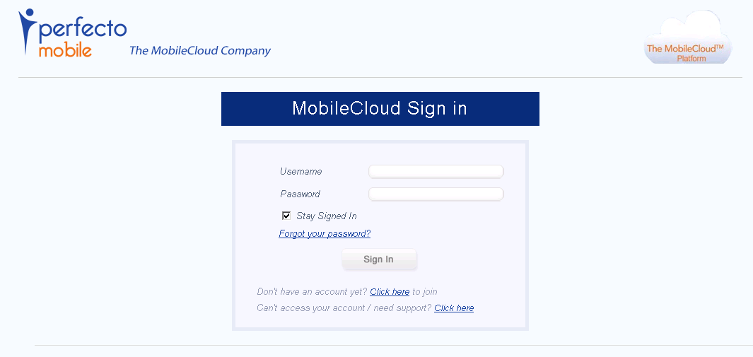
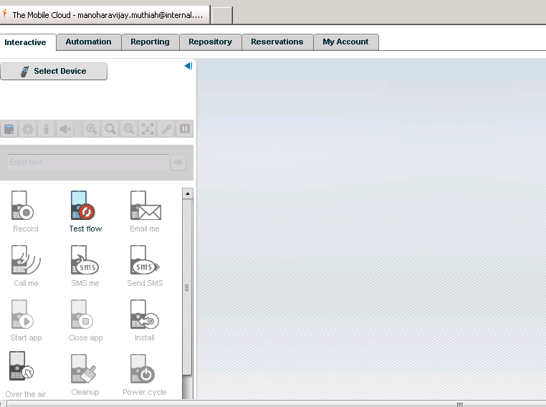
Test Execution – Using Perfecto Mobile
Enter into www.perfectomobile.com
Click on Sign in
Enter the User name detail (will get after License)
After Login Click on “Select Devices” button

Slide 9
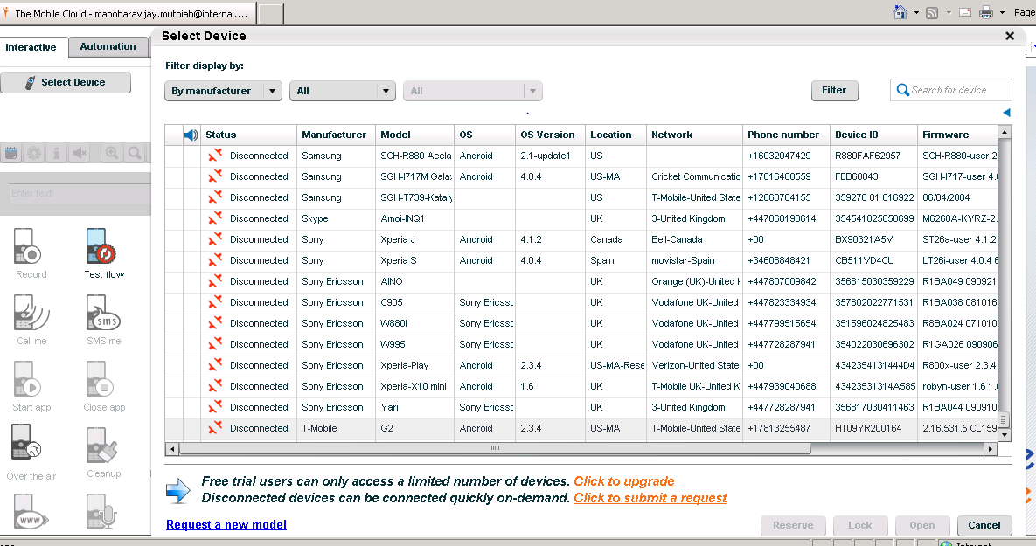
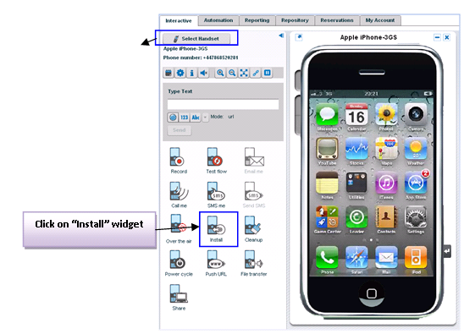
Test Execution – Using Perfecto Mobile Cont..
All Devices will be displayed with availability status and details
Filters option are available
Select the Device, Reserve and open it
Upon Open, Click on Install

Slide 10
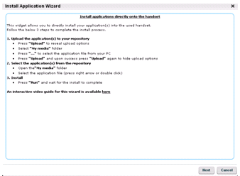
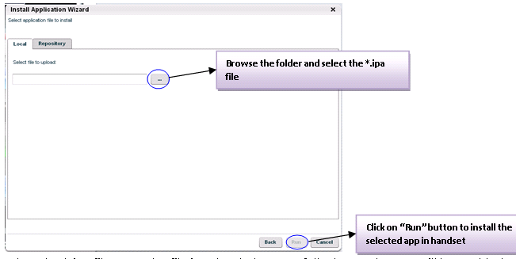
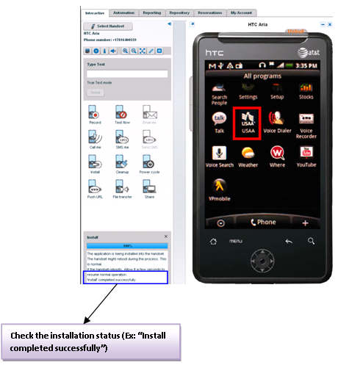
Test Execution – Using Perfecto Mobile Cont..
1
2
3

Slide 11
Test Execution – Using Perfecto Mobile Cont..
Key Points about Perfecto Mobile:
Perfecto mobile has two type of Clouds – Private and Public
Perfecto mobile has hourly license and unlimited license http://www.perfectomobile.com/portal/cms/pricing/
Perfecto Mobile has privilege to do Native automation as well as Performance Testing
Perfecto can be integrated with UFT to do automation.
Both Wi-Fi and Carrier devices are available in Perfecto.
Testing on Multiple devices can be done simultaneously.
Have option to Wipe out all the datas\Apps when ever we close the device after use

Slide 12
Challenges
The functionality of the app or the user experience is expected to remain consistent across multiple devices of similar/varying platforms
Time constraints
Network Variations- Network connectivity would be inconsistent and mostly very bad during the peak hours (mostly 6-10pm), which may lead to inconsistent results.
The increased and continuous launch of new devices into market

Slide 13
Other Mobile Testing Tools:
1. Device Anywhere for Cloud:
Price Details are available in http://www.keynotedeviceanywhere.com/test-center-pricing.html
2. Fone Monkey for Automation:
1. Sign Up with Fone Monkey
2. Download the Monkey Talk and install the IDE in applications
3. See Test for Automation:
1. Free Trial for 10 days can be downloaded from the See Test site after signup.

Slide 14



Slide 15
Mobile Testing
Version 1.0: Manohara Vijayan Muthiah & Muralidharan Veerapathiran

